Slide 1

ECE 330: Power Circuits and Electromechanics
Subhonmesh Bose
Electrical and Computer Engineering,
University of Illinois at Urbana Champaign
ECE 330, Spring 2018

Slide 2
Course topics
Phasors and three phase circuits
Magnetic circuits and transformers
Electromechanical energy conversion
Stability of dynamical systems
Generator and motor designs
…the principles behind the electric power system

Slide 3
Electric power system
An electric power system is a network of electrical components used to supply, transfer and use electric power. Courtesy: Wikipedia
Supply = generate
Transfer = transmit and distribute
Use = consume
*Images in the presentation are taken from various sources on the internet unless mentioned otherwise, including Wikipedia, Hyperphysics, among others.

Slide 4
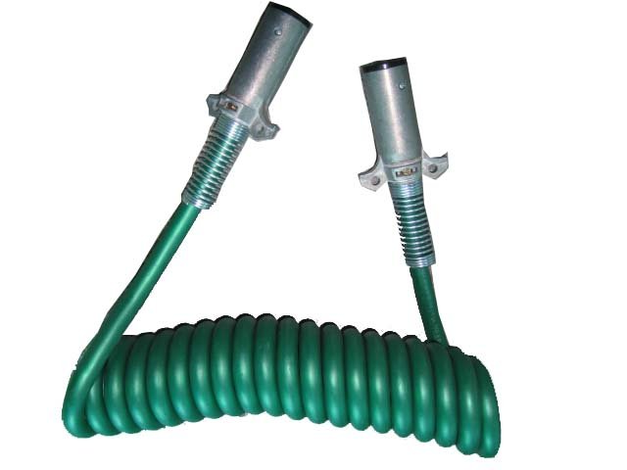
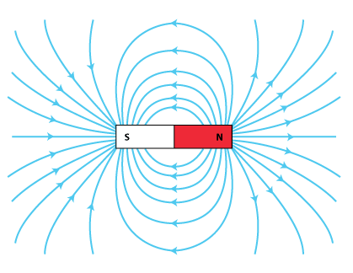
Generating electricity
Faraday’ law
Changing flux creates a voltage across the coil
Q. How do we “change” flux?
A. Two ways:
  Change strength of magnetic field
  Move the magnet around

Slide 5
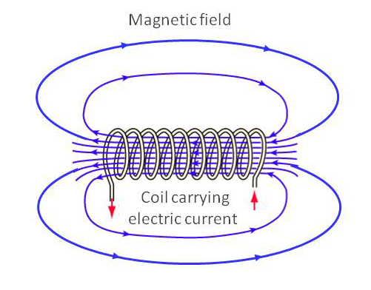
Generating electricity
Ampere’s law
Electric current produces a magnetic field
Q. How do we “change” flux?
A. Two ways:
  Change electric current
  Move the coil around

Slide 6
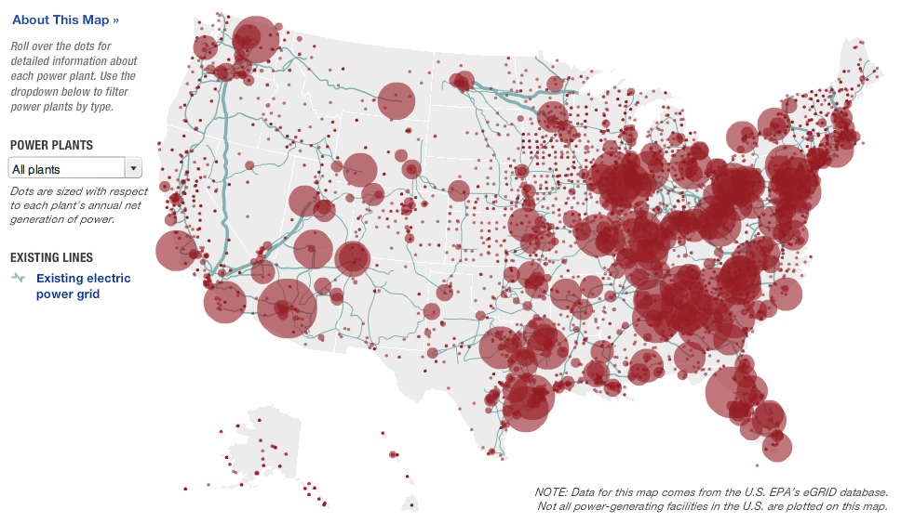
Generating electricity

Slide 7
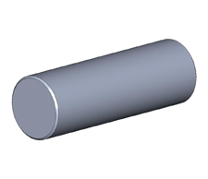
Transmitting electricity
Piece of wire

Slide 8
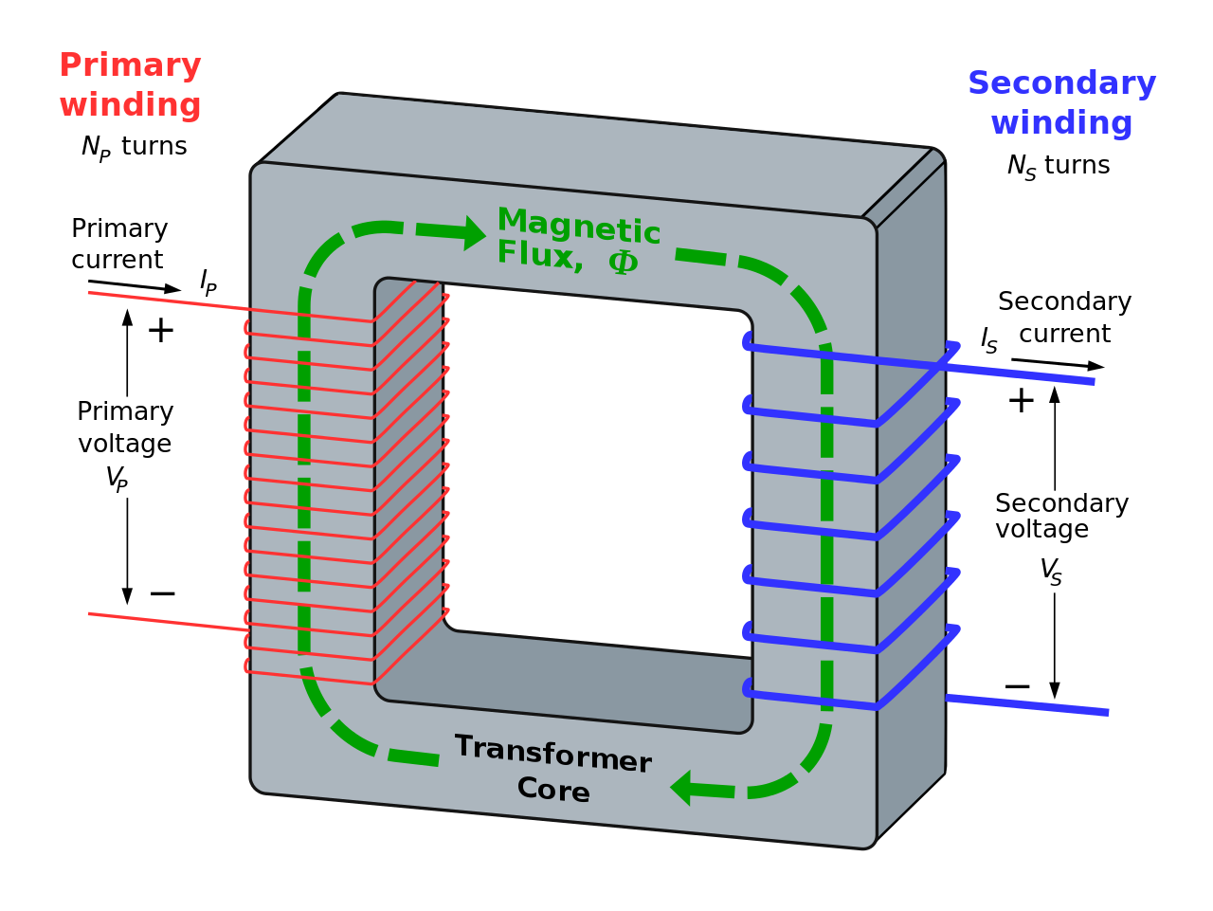
Transmitting electricity

Slide 9
Transmitting electricity

Slide 10
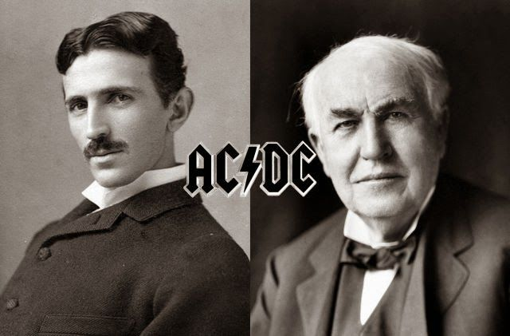
Transmitting electricity

Slide 11
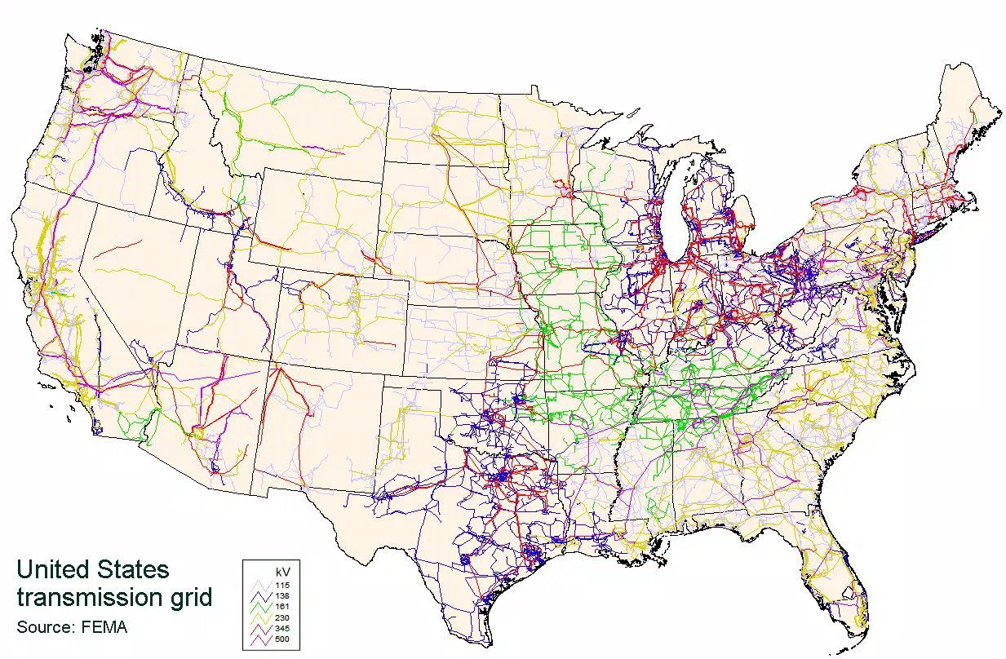
Transmitting electricity

Slide 12
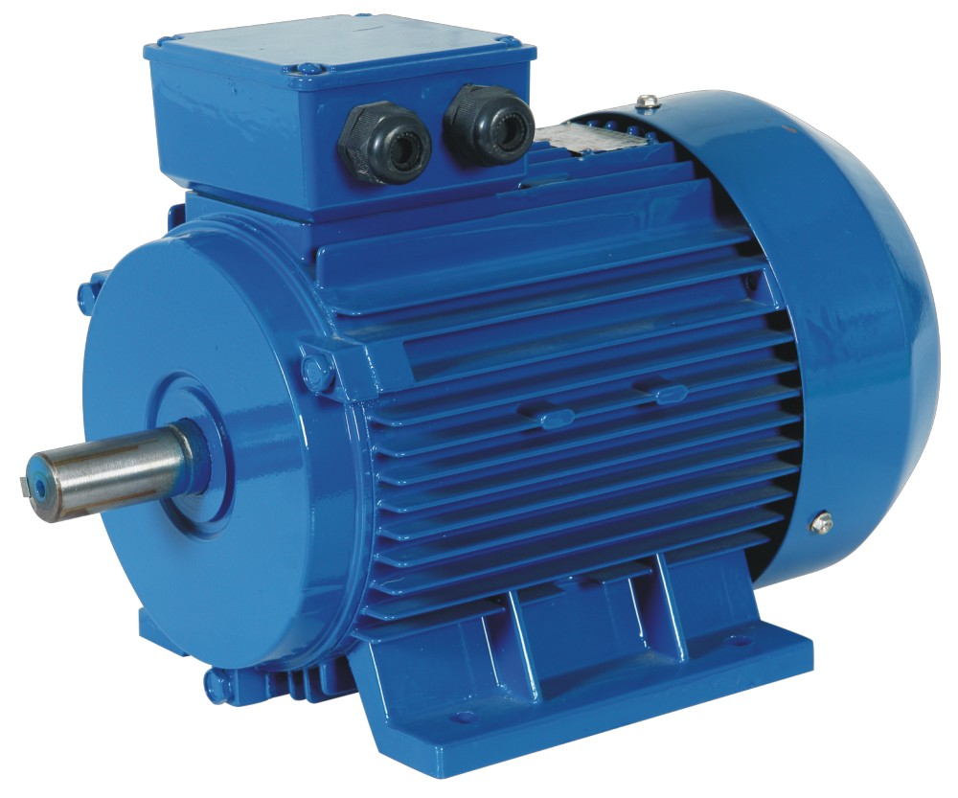
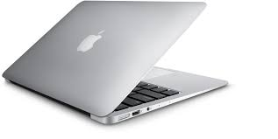
Consuming electricity

Slide 13
Consuming electricity
Lorentz force
Current carrying wire in a magnetic field experiences a force
Use this force to move a coil.

Slide 14
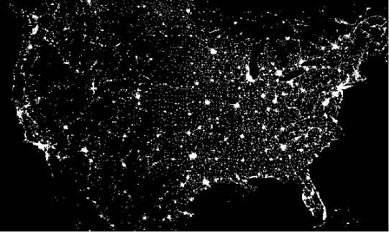
Consuming electricity
Courtesy: NASA

Slide 15
Course topics
Phasors and three phase circuits
Magnetic circuits and transformers
Electromechanical energy conversion
Stability of dynamical systems
Generator and motor designs
…the principles behind the electric power system

